Slide 1

The National Government
Service Centre
An introduction to our services for citizens, business owners and new arrivals.

Slide 2

More than 10 million people live in Sweden and for the most part, the contact between citizens and government agencies takes place digitally.
Most of us are used to accessing public services digitally, but not all.

Slide 3
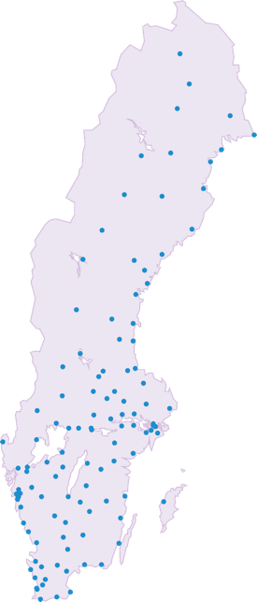
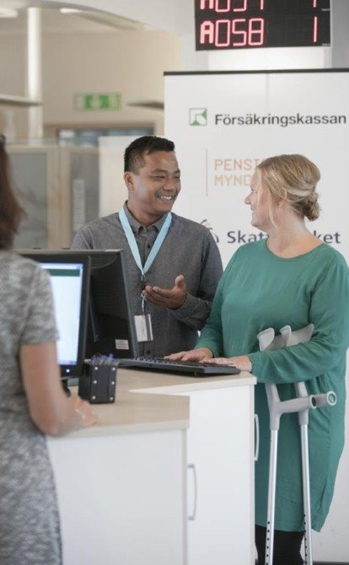
To make interaction between individuals and government agencies as safe and accessible as possible, there is The National Government Service Centre.
We offer personal assistance and guidance in physical meetings.

Slide 4
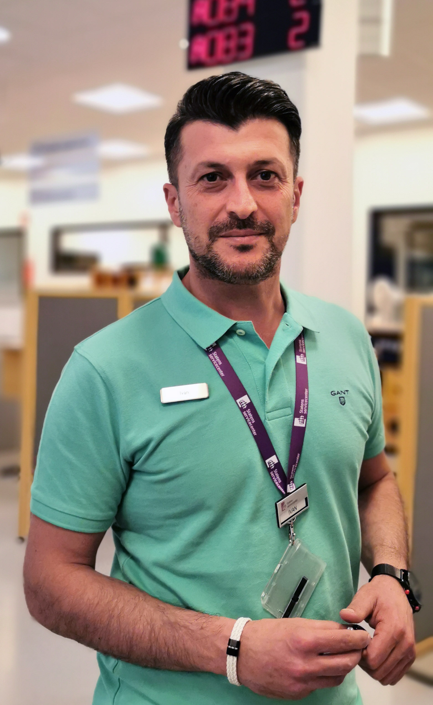
At our service centres, our professional service administrators are ready to satisfy every visitor’s need for individual help.
We can offer citizens unique support, thanks to our collective and broad competence regarding services from various government agencies.

Slide 5
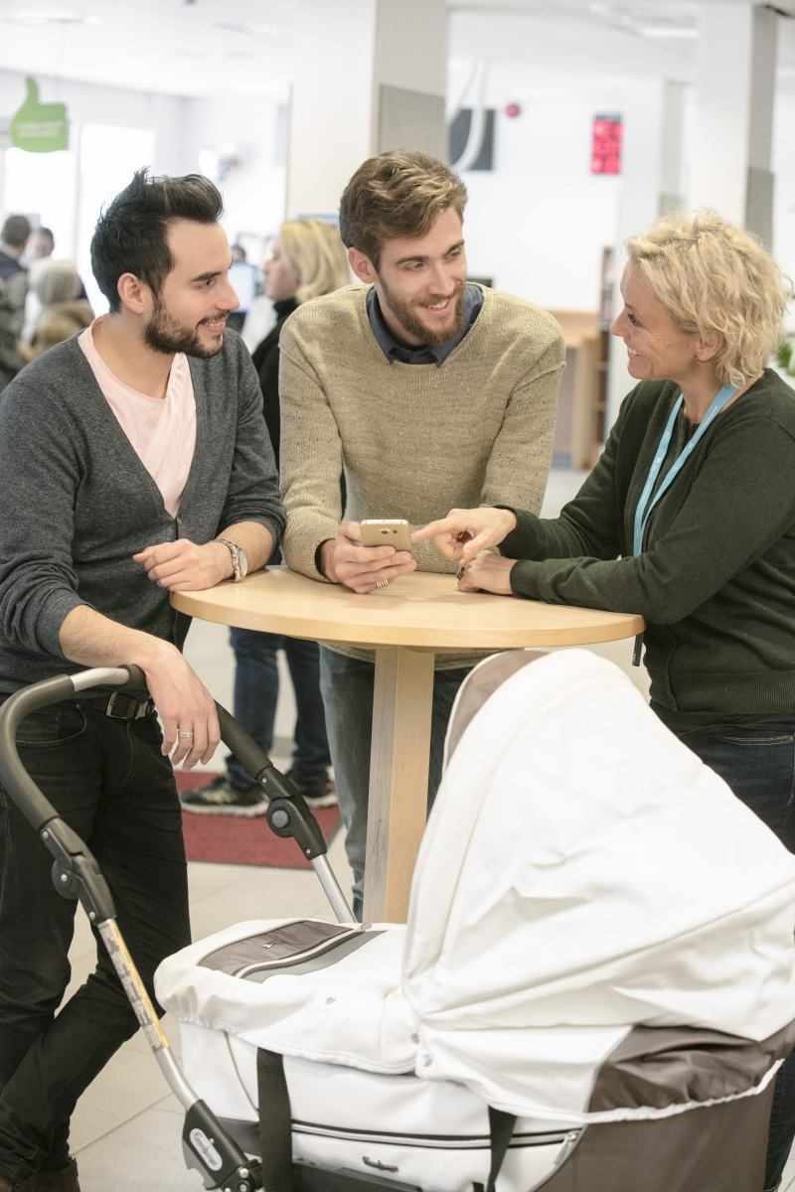
For example, questions could be about
work, taxes, citizenship or marriage.
Everyone living in Sweden should have
an equal opportunity to get in touch with government agencies, regardless of
language skills or digital experience.

Slide 6
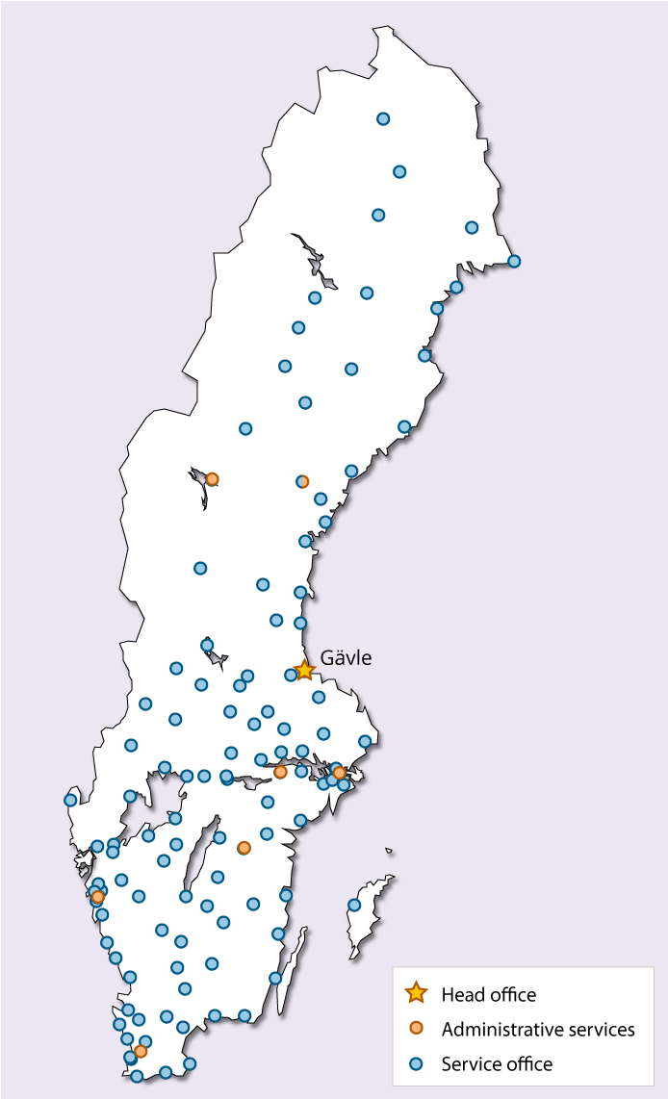
Today, we are located in 117 different places in Sweden, and new offices are being opened in towns and cities where a need and the right conditions exist.

Slide 7
Today, we can help visitors with matters regarding:
The Swedish Public Employment Service
The Swedish Social Security Agency
The Swedish Pensions Agency
The Swedish Tax Agency

Slide 8





And we can help visitors who are, for example:
Looking for a job
New as a parent
Newly arrived in Sweden
About to get married
Soon to be retired

Slide 9
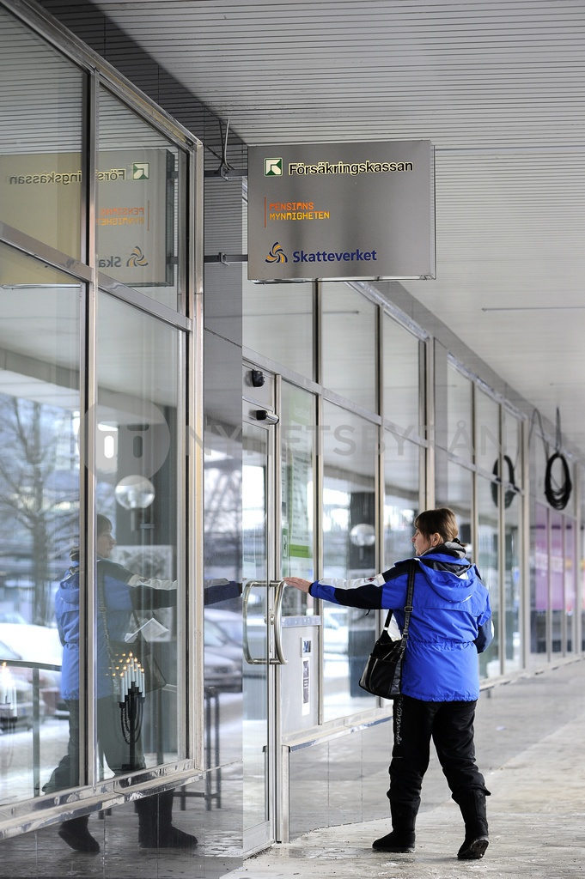

The National Government Service Centre is a physical meeting place for different services offered by the state of Sweden.
Our goal is to be able to offer services from even more government agencies.

Slide 10
To make the meeting between
government agencies and residents
as easy as possible.

Slide 11
Welcome to
The National Government Service Centre www.statenssc.se
Notes:
Finally, thank you so much for your attention. You can find more information about us on our website, www.statenssc.se.

